Slide 1

Swifast Website 1.0
Team Members: Nathally Perez and Mariana Sebastian Product Owner: Kianoosh G. Boroojeni
Instructor: Masoud Sadjadi School of Computing and Information Sciences Florida International University
Final Presentation
Spring 2017
The logo of your project

Slide 2
Project definition
Problem:
Technology for driverless cars is evolving in this competitive market and the best way to promote and attract potential customers is by providing a high tech, modern and efficient application. Swifast website provides an easier way to promote navigation software.
Current system(Solution):
Swifast website is a responsive website that supports all the browsers and it contains useful information about the product for visitors and also a blog page to keep users inform. The website provides a homepage, blog page, about us page, contact us page, product page, technology page, and a subscription form.

Slide 3
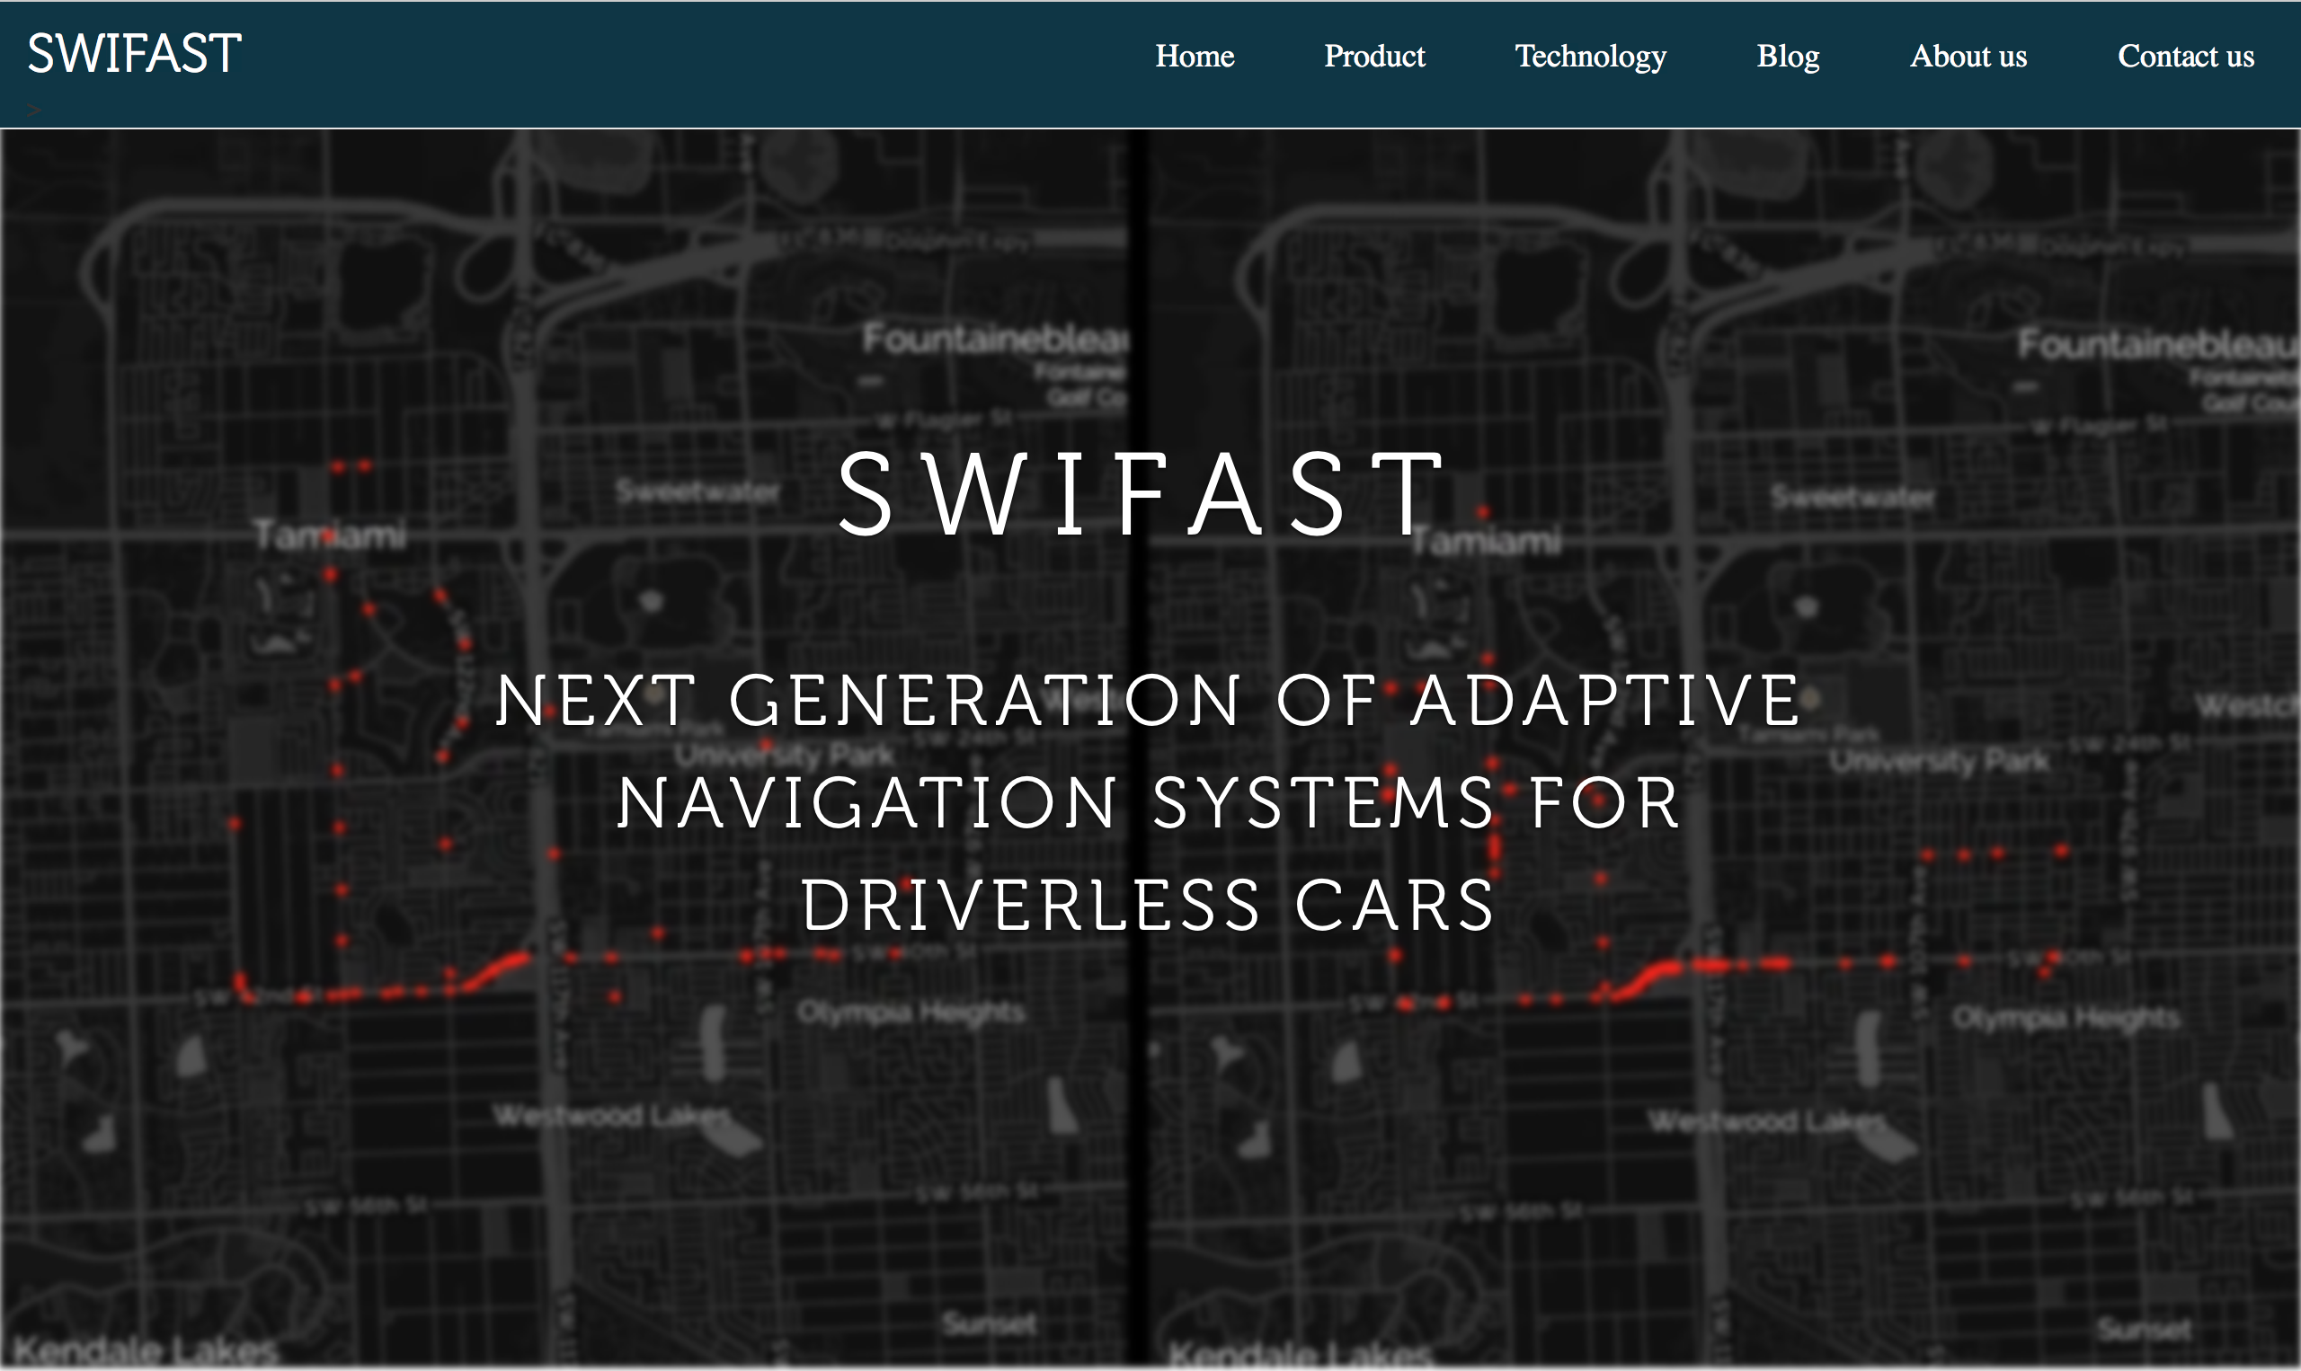
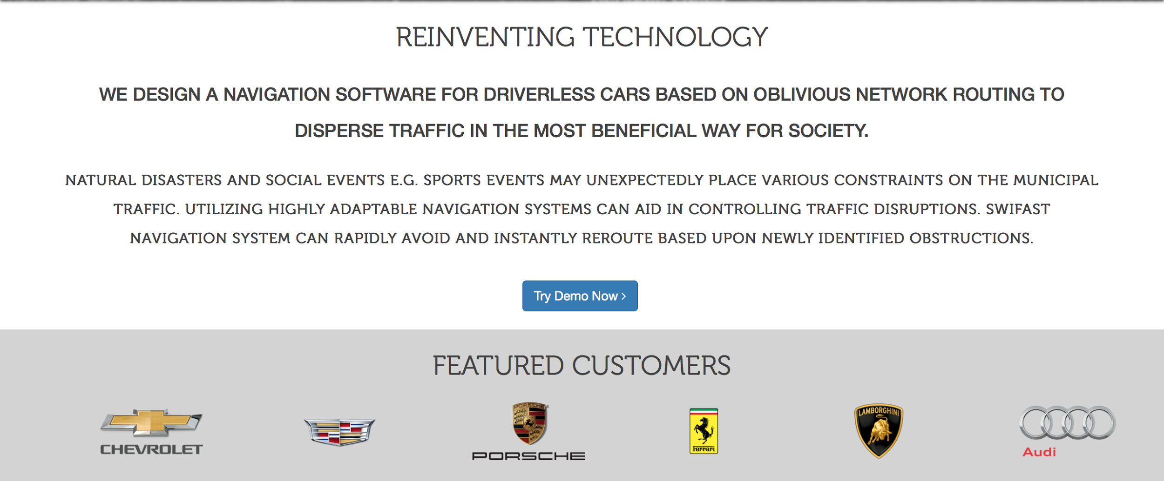

Slide 4
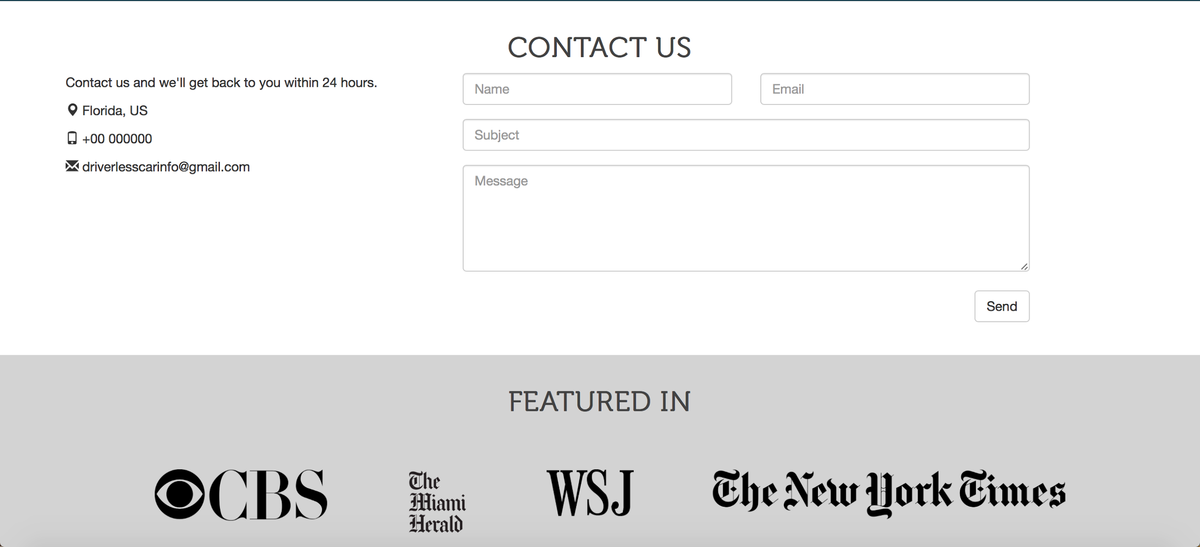
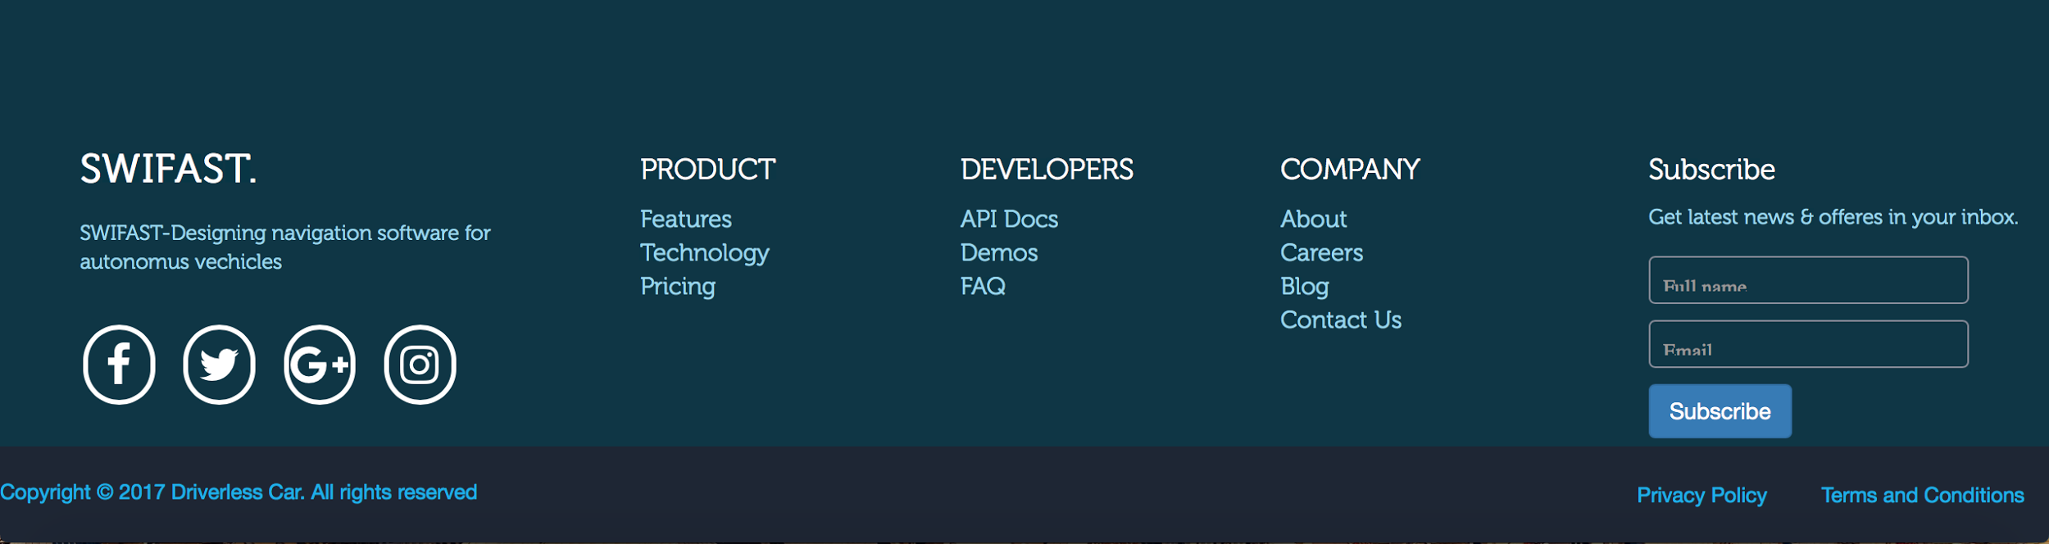

Slide 5
Requirements: Use Cases
The use case diagram for our system is provided in the next slide.

Slide 6
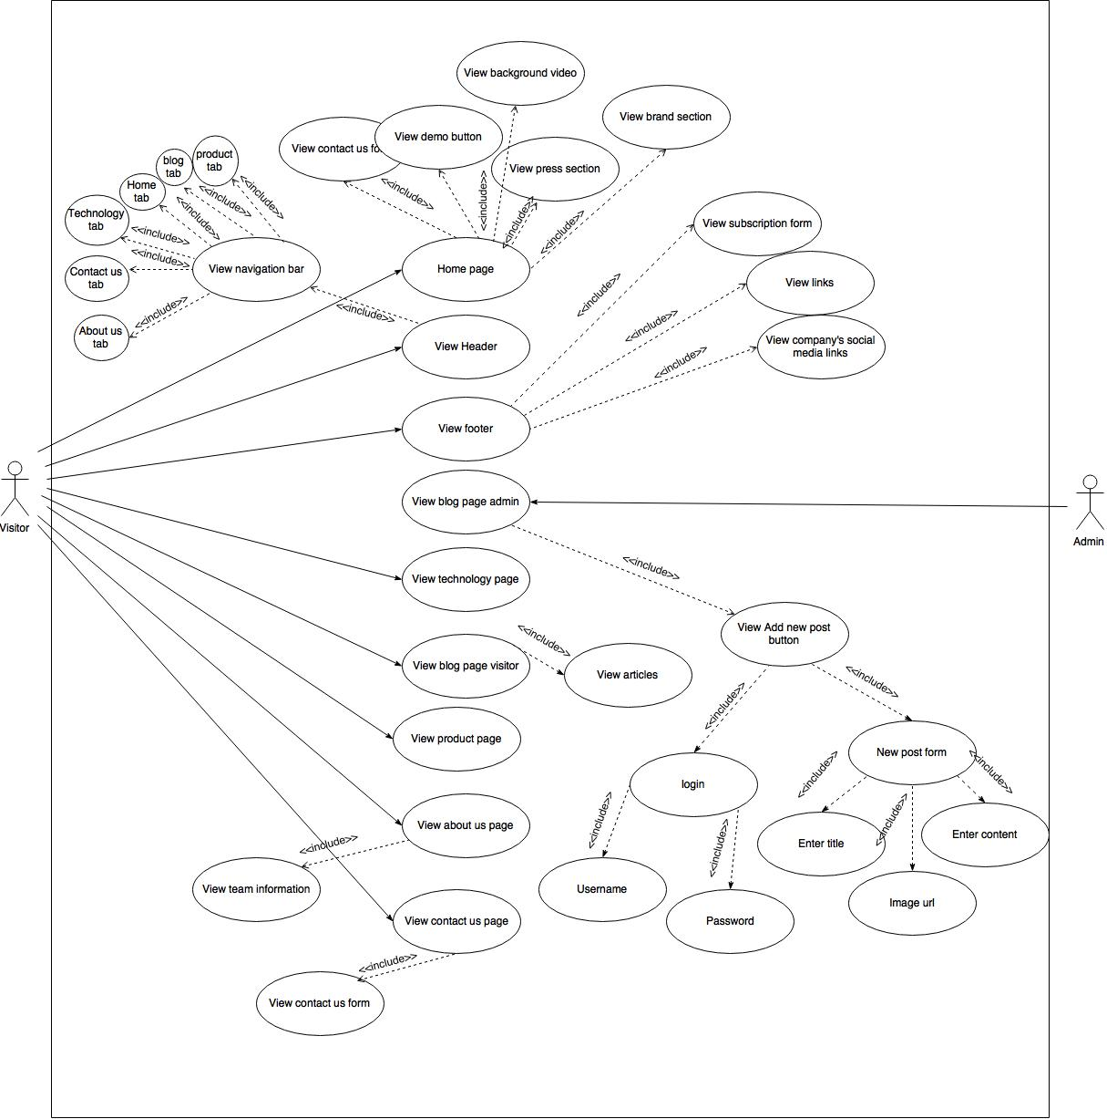

Slide 7
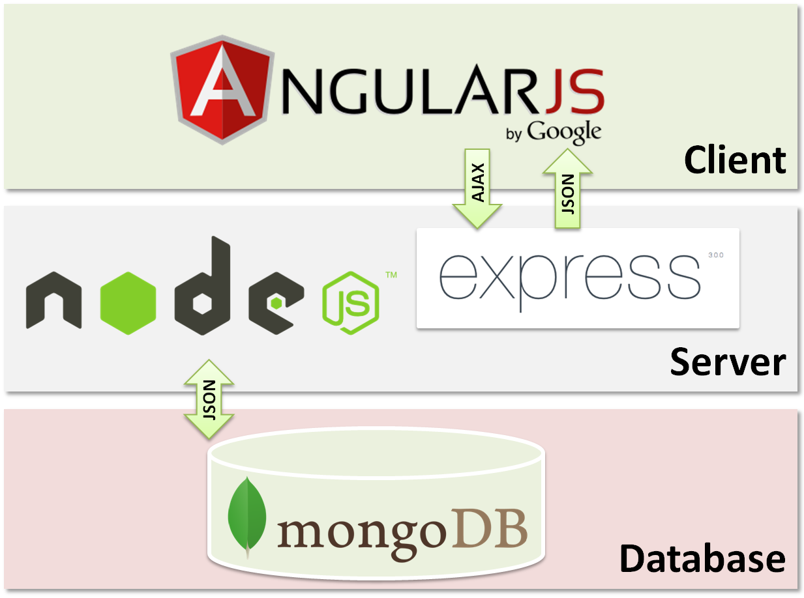
System Design: Architecture

Slide 8
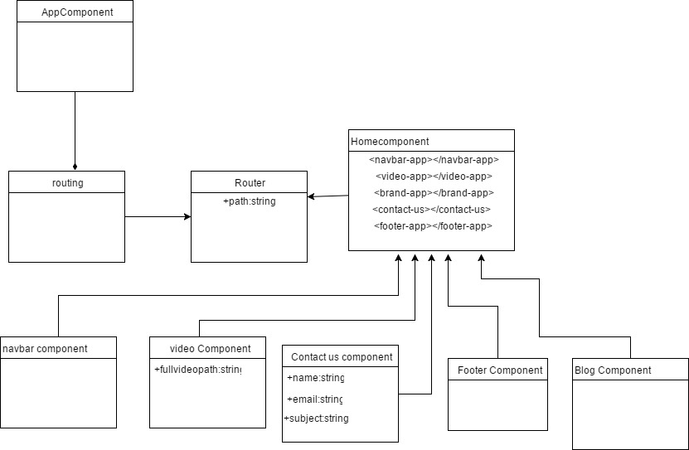
Minimal Class Diagram

Slide 9
User Stories
#117 Create a homepage with high-tech look
#120 Set Up the Localhost Server
#119 Create Routes
#176 Create routes and components using angularJs
#197 Blog Page
#122 Set up an admin login page
#208 Add blog post
#215 Implementing subscription form
#216 Implementing contact us form

Slide 10
User Story #117 Create Homepage with High-tech Look
Description:
As a user, I would like to be presented with a high tech home page, so that I could find the information very easy.
Acceptance criteria:
Homepage should contain header and footer
Homepage header should contain Home, Product, Technology, Blog, About us and Contact us tabs
Homepage footer should contain Social media, Product, Technology, Blog, About and Contact us links and subscription form..

Slide 11
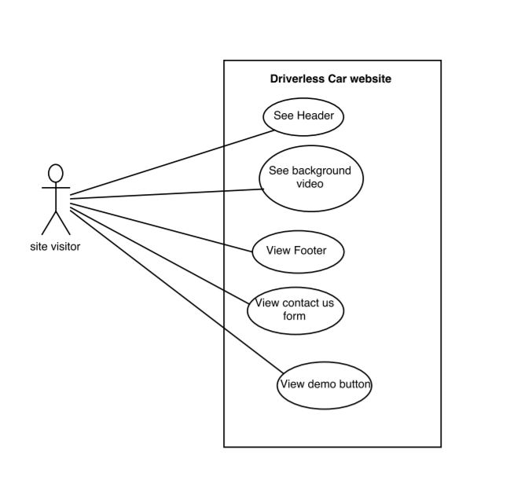
Use case #117:
Name: Create Home page
Actor: site visitor
Preconditions: Connected to http://localhost:3000
Description:
Users can find tabs about about us, technology, product, team, contact us in the header section.
User can scroll down to find more information in the website
User can find the footer with copyright information at the bottom of the website.

Slide 12
Sequence diagram #117

Slide 13
User Story #119 Create Routes
Description:
As a developer, I want to create routes so that my application will respond to a client request to a particular endpoint.
Acceptance Criteria
Web page should be properly rendered to the appropriate tabs

Slide 14
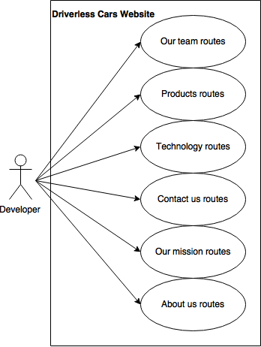
Use case #119:
Name: create routes
Actor: developer
Preconditions:
Developer have access to the internet
Server is running on port 3000
Description <Flow of events>:
Go to browser
Enter http://localhost:3000
Get request to server
Go to http://localhost:3000/contactus
Go to http://localhost:3000/about
Go to http://localhost:3000/blog
Go to http://localhost:3000/technology
Go to http://localhost:3000/product
Get view of each different routes

Slide 15
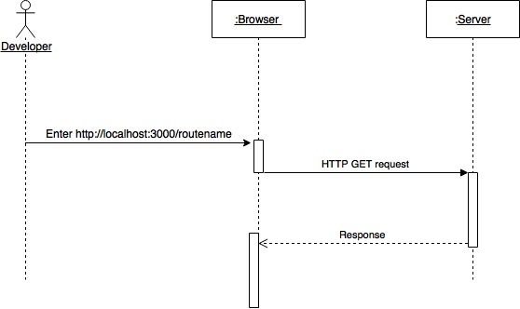
Sequence diagram #119

Slide 16
User Story #197 Blog Page
Description:
As a user, I want to be able see posted articles about driverless cars on the website, so that I can be inform of any tips and tutorials about driverless cars.
Acceptance Criteria
Web page should display articles properly.
Web page should display pictures posted by the author.

Slide 17
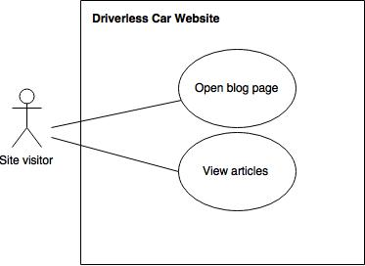
Use case #197
Name:Blog page
Actor:Site visitor
Preconditions: Have access to the internet
Description <Flow of events>:
Go to browser
Enter http://localhost:3000
Get request to server
Gets responds with homepage
Find blog bar on the navbar at the top of the page.
Clicks the blog tab in the navbar
Redirect to the blog page.
Find more information about tips and tutorials on driverless cars.

Slide 18
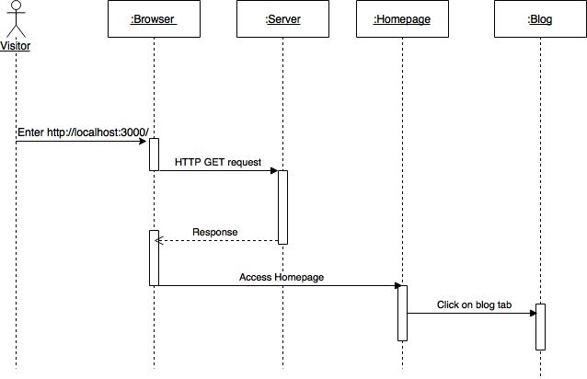
Sequence diagram #197

Slide 19
User Story #176
Description:
As a developer I would like to create routes and components for the front-end using AngularJS so that my web page will be more responsive and faster.
Acceptance Criteria
Web page should have different components
Web page should redirect to appropriate routes.

Slide 20
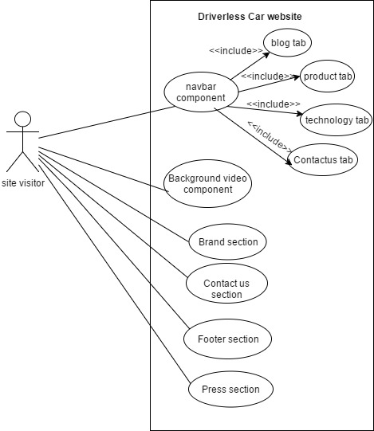
Use case #176
Name:Create routes and components using AngularJs
Actor:Site visitor
Preconditions: Connected to http://localhost:3000
Description <Flow of events>:
Users can find navbar at the top of the page containing Home, products, technology, blog, about us, and contact us menu items.
When user clicks the menu items in the navbar it will redirect to the appropriate page.
Users can scroll down to find out more information about driverless car company.
User can find the footer with copyright information at the bottom of the website.

Slide 21
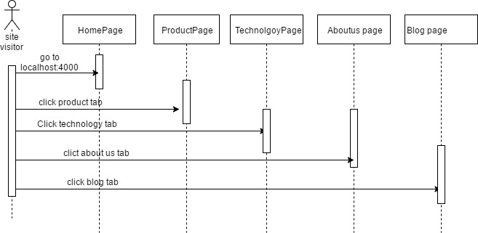
Sequence diagram #176

Slide 22
Class diagram #176

Slide 23
User Story #208 Add blog post
Description:
As an admin, I want to be able to add new post to the blog, so that I can inform the users with new stories about driverless car.
Acceptance Criteria:
Admin should be provided with add post button that contains the title, content and image url input fields.
Admin should be provided with the login form with appropriate input fields labeled.
User must be existed in the database.
An error message should display as when the user enters the invalid data.

Slide 24
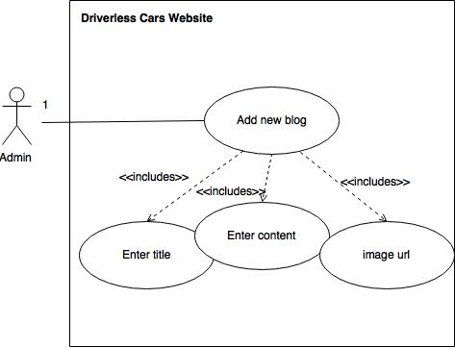
Use case #208
Name: Add blog post
Actor: Admin of the website
Preconditions: Connected to http://localhost:4000
Description <Flow of events>:
Click blog menu on the navigation bar.
Click add new blog post button on the page.
Enter login information and click login
Enter title, content and image url and click on create post
Redirected to blog page

Slide 25
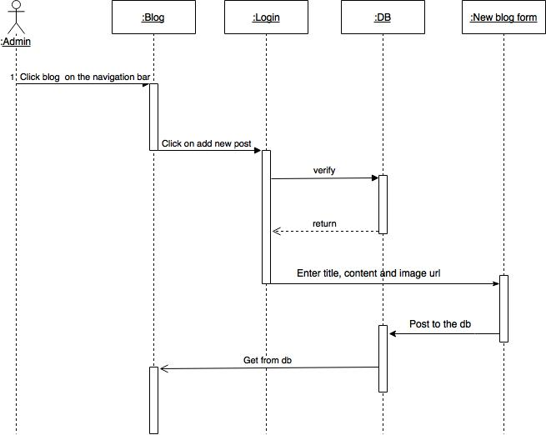
Sequence diagram #208

Slide 26
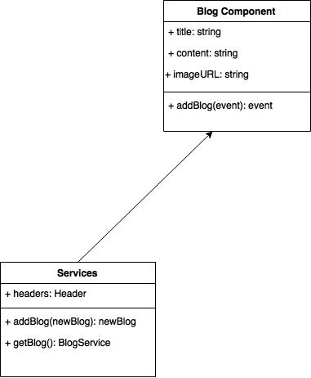
Class diagram #208

Slide 27
User Story #122
Description:
As an admin, I want to login to the website so that I can add or/and edit the blogs to my website.
Acceptance Criteria:
User should be provided with the login form with appropriate input fields labeled.
User must be existed in the database.
An error message should display as when the user enters the invalid data.

Slide 28
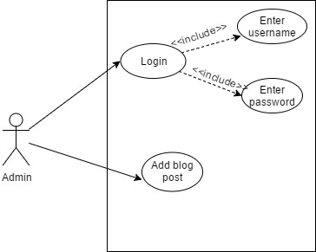
Use Case #122
Name: Set up an admin login page.
Actor: Admin of the website
Preconditions: Connected to http://localhost:4000
Description <Flow of events>:
Click blog menu on the navigation bar.
Click add blog post button on the page.

Slide 29
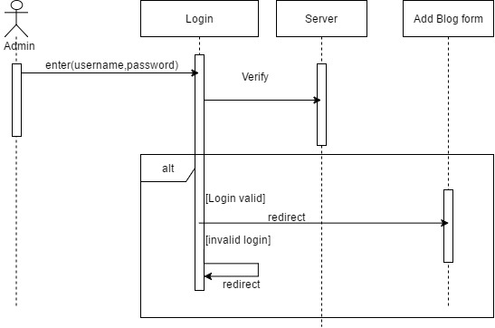
Sequence Diagram #122

Slide 30
User Story #215 Implementing subscription form
Description:
As a user, I want to be added to the driverlesscar mailing list, so that I will get updated news about the driverlesscar website.
Acceptance Criteria:
A subscription form should be provided
User information must be saved in the database
User will be provided a pop up box after entering their information

Slide 31
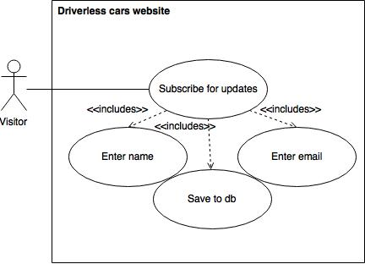
Use Case #215
Name:Implementing subscription form
Actor: User of the website
Preconditions: Have access to internet
Description <Flow of events>:
Enter http://localhost:4000 to the browser
Scroll down to footer
Enter name and email and click submit
Get pop up box
Post request to db

Slide 32
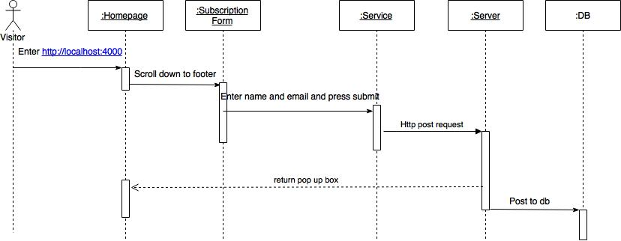
Sequence Diagram #215

Slide 33
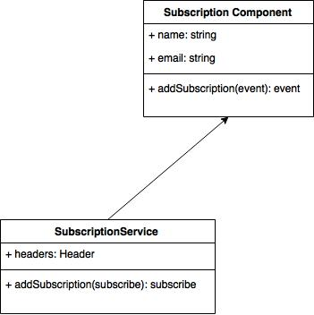
Class Diagram #215

Slide 34
User story #216 Implementing contact us form
Description:
As a User, I would like to sent emails to driverless clar owners, so that I can inquire more about their product and services and sent messages about any questions.
Acceptance Criteria:
User should be able to enter their name, email address, subject, and message in their contact us form.
Form should be labeled with appropriate name.

Slide 35
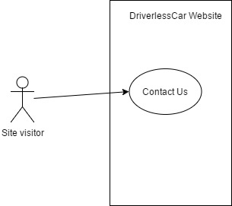
Use Case #216
Name: Implement contact us form
Actor:Site visitor
Preconditions: Connected to http://localhost:4000
Description <Flow of events>:
User clicks contact us tab from the navbar
User is presented with contact us form
User fill out the informations in the form.
User clicks submit button

Slide 36
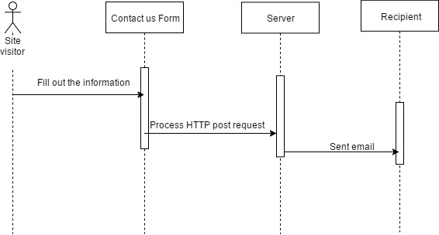
Sequence Diagram #216

Slide 37
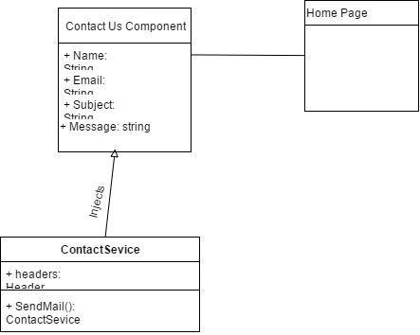
Class Diagram

Slide 38
Test Suite and Test Case: Subscriber form submitted
Description | Ensure that the subscriber information is being stored to the db properly.
Precondition | The server is running on the localhost Visitor is in the homepage Visitor scrolls down to footer Visitor enters: a. name b. email 5. Visitor clicks on subscribe button
Expected Result | Subscription form is sent correctly
Actual Result | Subscription form was sent successfully
Status | PASSED

Slide 39
Test Suite and Test Case: Add Blog post
Description | Admin adds blog post
Precondition | The server is running on the localhost Admin is in the homepage Click blog menu on the navigation bar. Click add new blog post button on the page. Enter login information and click login Enter title, content and image url and click on create post Redirected to blog page
Expected Result | Post is added
Actual Result | Post is successfully added to the blog page
Status | PASSED

Slide 40
Summary
Conclusion:
This is the first version of Swifast website and the purpose was to provide a modern look website where customers can easily find navigation software for driverless cars while providing them useful information of our company and allowing customers to communicate with us.
Contributions:
Mariana and Nathally contributed to everything in the project. We made sure we were up to date with the daily scrum meetings, Mingle, Google drive documentation and all the requirements for the project.

Slide 41


Thank you any questions?
Nathally Perez: npere181@fiu.edu
Mariana Sebastian: mseba003@fiu.edu

